Slide 1


THE NEW AGE OF WEB SERVER
Submitted by,
Tripti Singh
Sejal Shrestha
Samarth Srivastava
18070124074
18070124064
18070124070

Slide 2
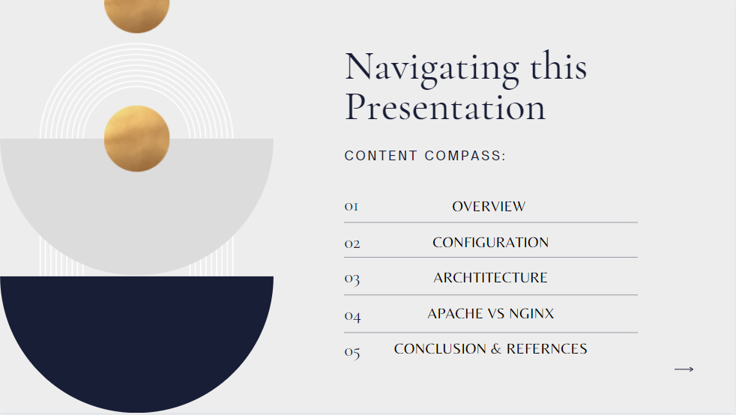

Slide 3
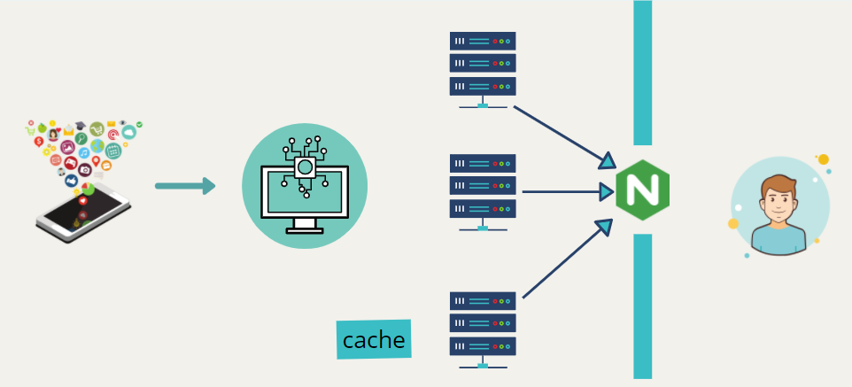
NGINX is a high-performance, high concurrency, and low resource usage web server developed to facilitate the increasing needs of the modern web.

Slide 4
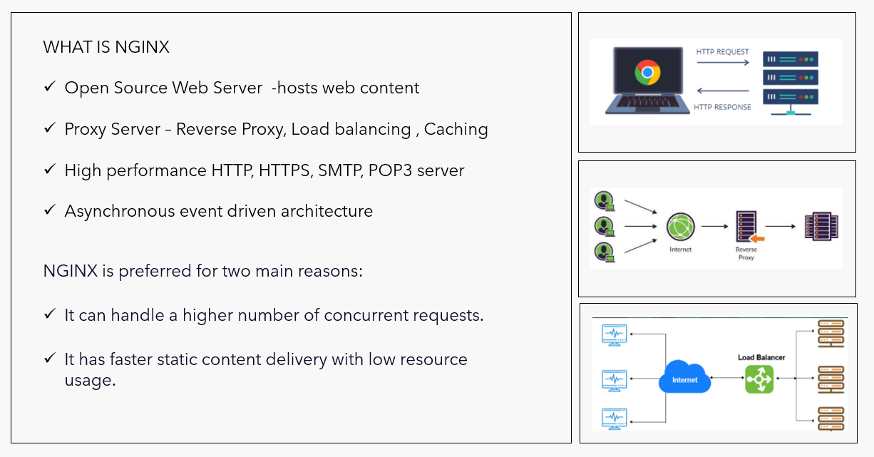

Slide 5
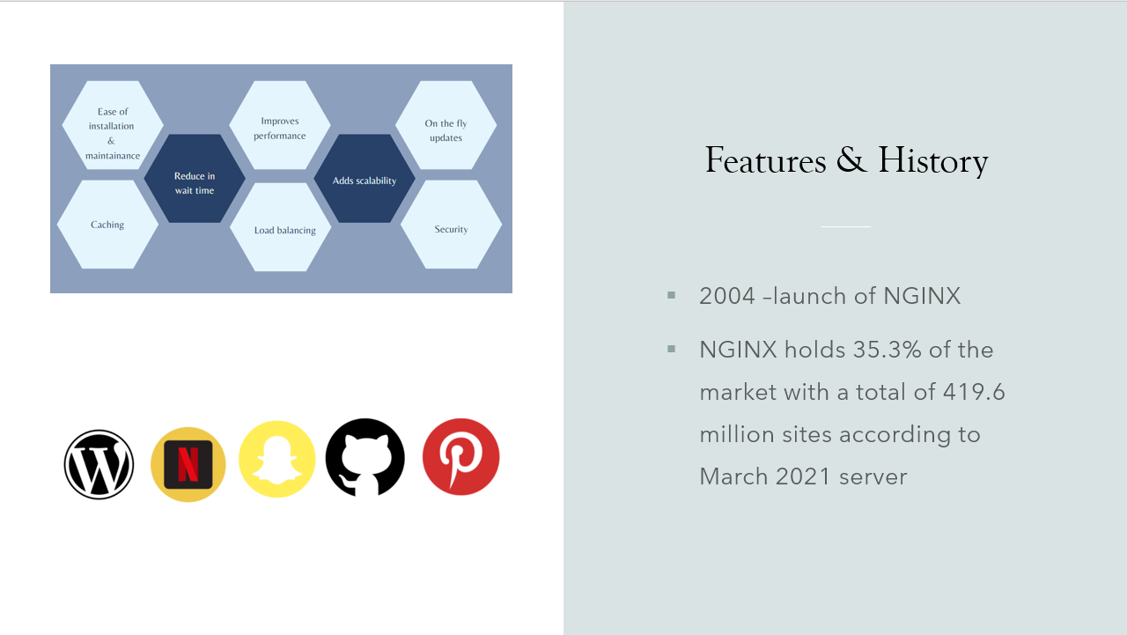

Slide 6
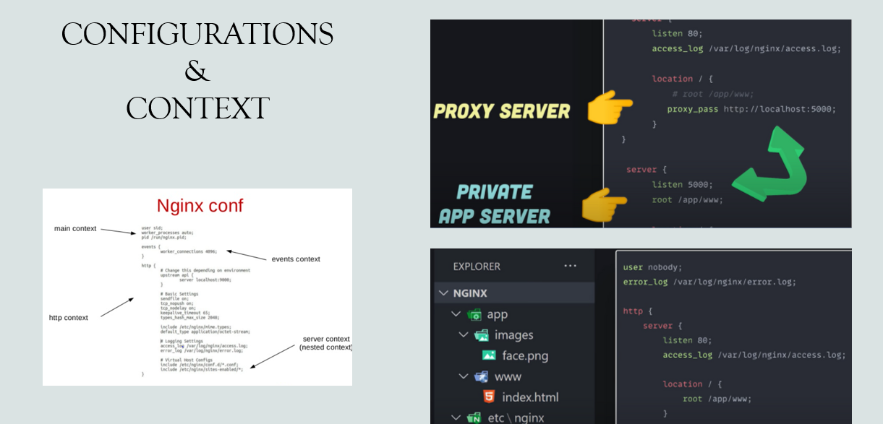

Slide 7
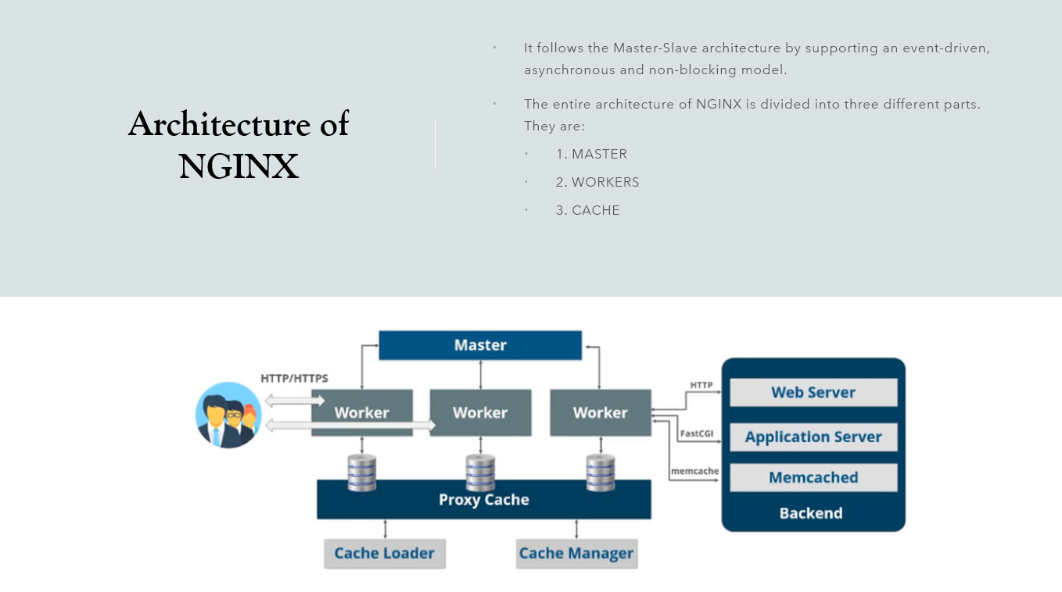

Slide 8
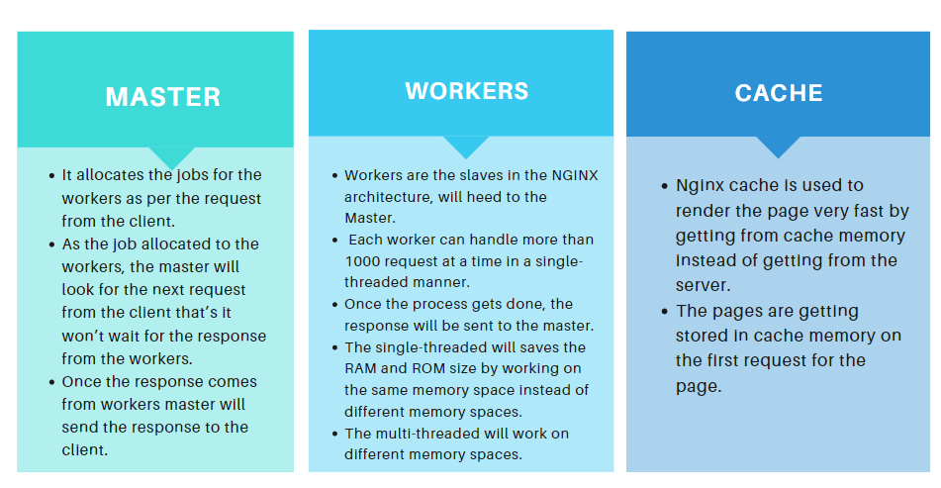

Slide 9
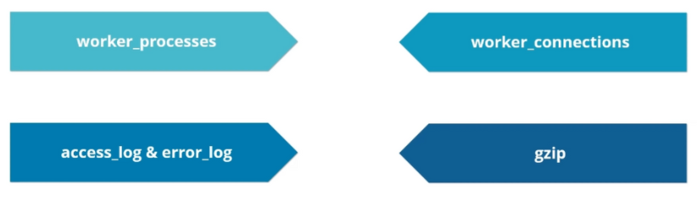
Configurations of NGINX
The core settings of the NGINX are mainly configured in the nginx.conf file.
The configuration file is mainly structured into 4 different Contexts, namely:

Slide 10
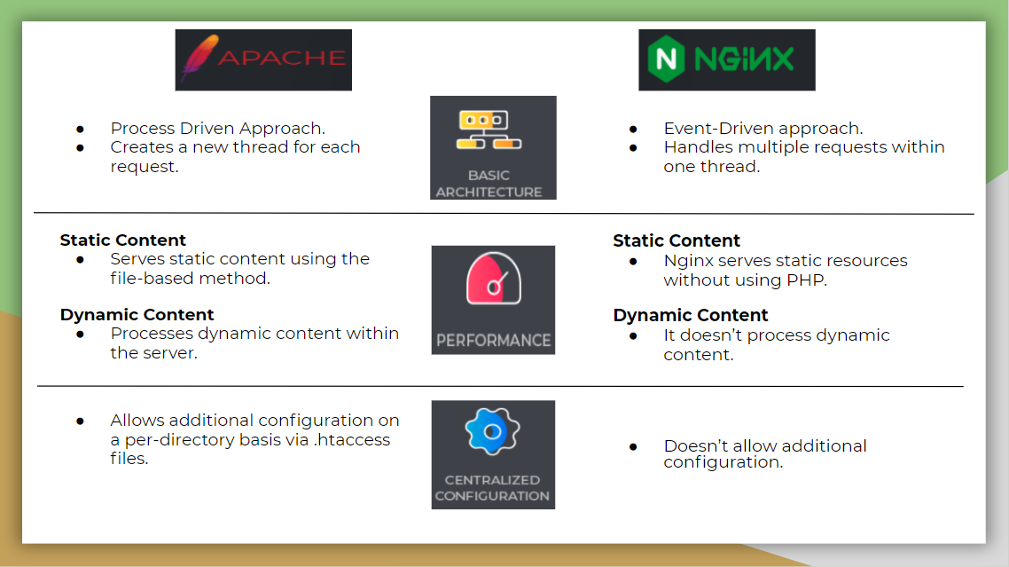

Slide 11
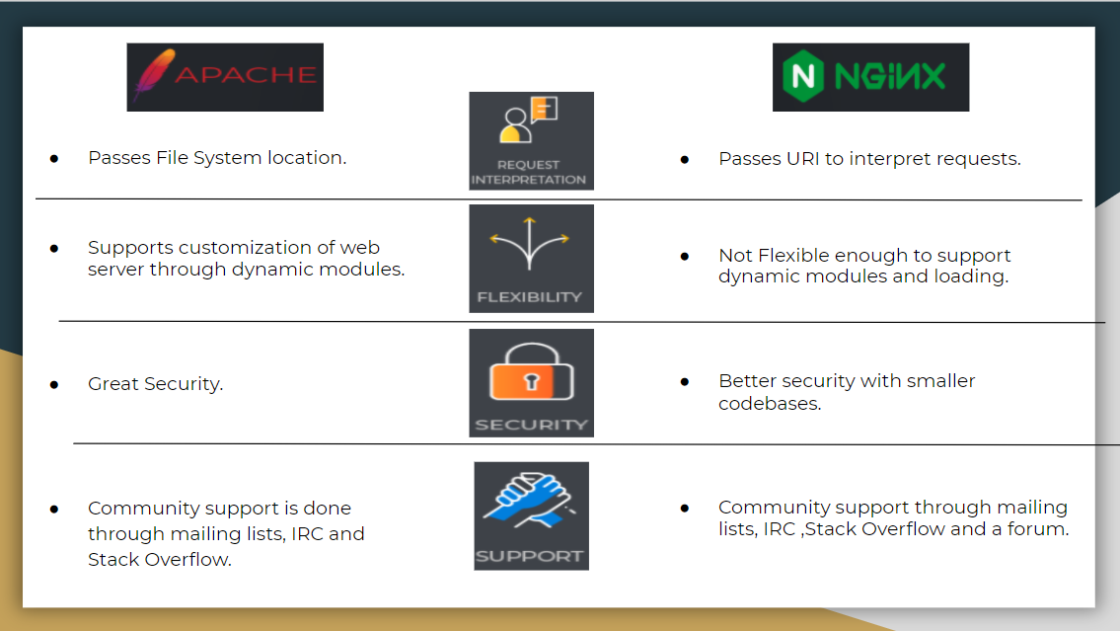

Slide 12
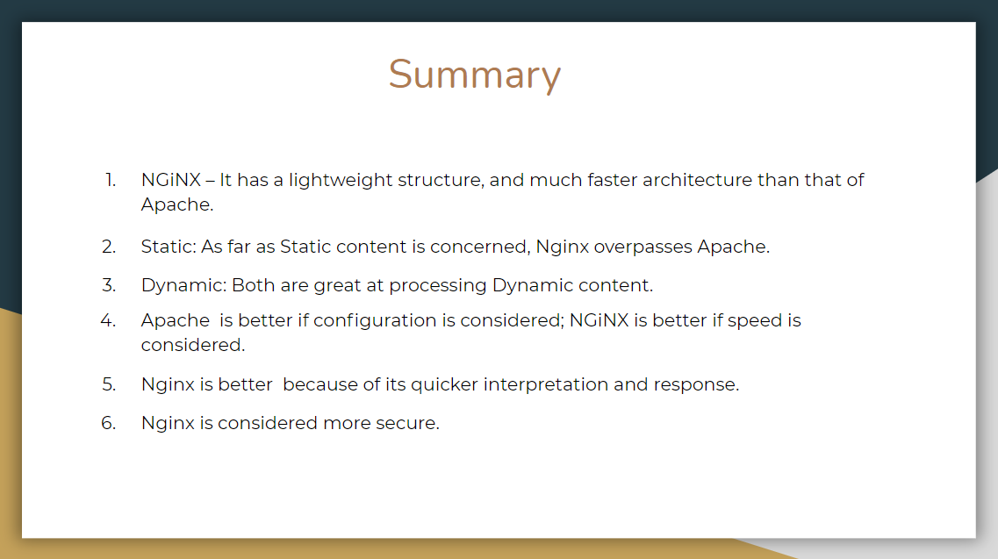

Slide 13
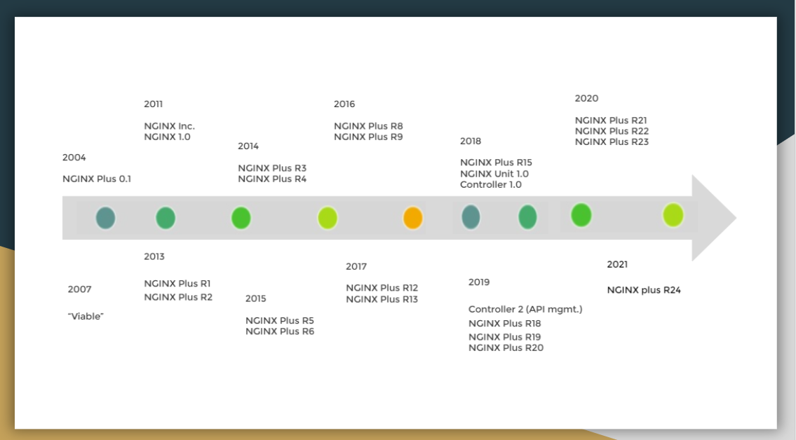

Slide 14
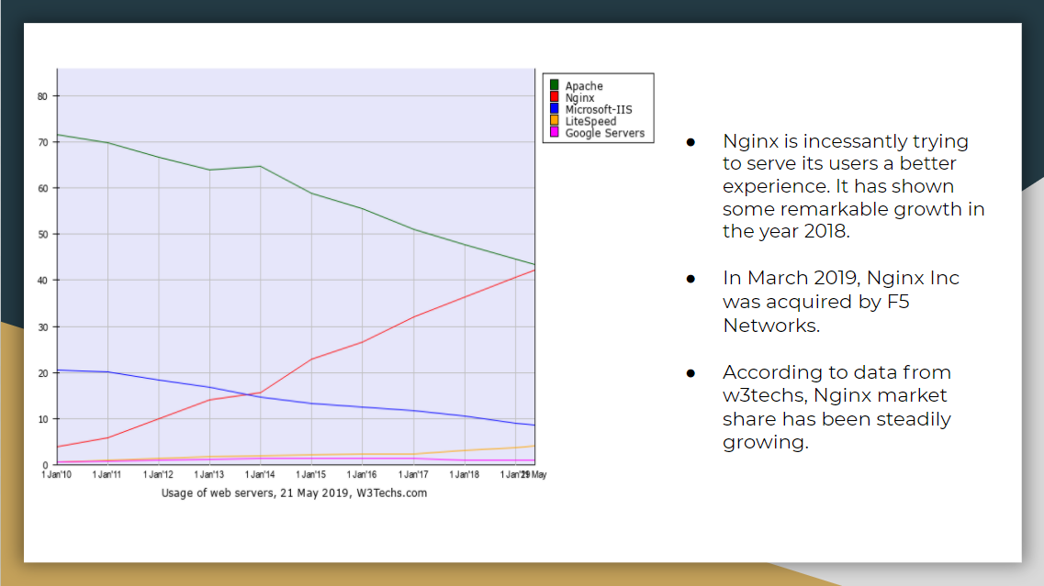

Slide 15

REFERENCES
[1] https://www.freecodecamp.org/news/the-nginx-handbook/
[2] 2 Hours NginX Crash Course + Bonus Content – YouTube
[3] NGINX Explained in 100 Seconds – YouTube
[4] https://www.hostingadvice.com/how-to/nginx-vs-apache/
[5] https://www.nginx.com/blog/future-nginx-nginx-plus/#massivepace
[5] https://docs.nginx.com/nginx/releases/

Slide 16
Q & A

